Slide 1
SignBridge: Bridging Communication with Sign Language
Team members: project guide:
b. V. Venkat (21761A0507) Mrs. M. Gayathri
V. Soma Sundara Reddy (21761A0561) Assistant Professor
A. Harshitha (21761A0519)

Slide 2
Abstract
In a world where communication is key, barriers faced by deaf and mute individuals can be significant. "SignBridge" is a pioneering project designed to bridge these communication gaps by converting spoken and written language into sign language videos. Leveraging advanced machine learning techniques, SignBridge transcribes audio input into text, which is then seamlessly translated into sign language using a curated dataset of animated videos. The core of the project lies in its ability to provide real-time translation, making interactions with deaf and mute individuals more inclusive and accessible. This solution not only fosters better understanding but also empowers communities by ensuring that communication is no longer a barrier. SignBridge aims to be a versatile tool, applicable in various settings, from educational environments to customer service, ensuring that everyone, regardless of their hearing ability, can communicate effectively and meaningfully.

Slide 3
introduction
In today's world, communication is a fundamental aspect of daily life. However, deaf and mute individuals often face significant barriers that hinder their ability to engage and interact with others effectively.
SignBridge is an innovative project designed to address these challenges by transforming spoken and written language into sign language videos. Leveraging cutting-edge machine learning techniques, SignBridge transcribes audio inputs into text and translates them into sign language using a carefully curated dataset of animated videos.
This project aims to facilitate real-time translation, ensuring that interactions with deaf and mute individuals are inclusive and accessible. By bridging communication gaps, SignBridge empowers communities, fosters better understanding, and ensures that communication is no longer a barrier.
Our goal is to make SignBridge a versatile tool applicable in various settings, from educational environments to customer service, ensuring effective and meaningful communication for everyone, regardless of their hearing ability.

Slide 4
Literature survey
Paper Name | Authors | Algorithm | Advantages | Disadvantages
Audio To Sign language Converter | Ms. Satvika Reddy Satti | Natural Language Processing | Flexibility: NLP algorithms can handle a wide range of text inputs. | NLP models often struggle with understanding the context or nuances of spoken or written language.
Deep learning based assistive technology on audio visual speech recognition for hearing impaired(paper1) | L. Ashok Kumar, D. Karthika Renuka, S. Lovelyn Rose | RNN-GRU for speech-to-text conversion. CNN for visual speech-to-text conversion (lip reading). | Lowered word error rate (WER) to 6.59% for the automatic speech recognition system. | Current methods may still require further improvements, especially in extreme noisy conditions.

Slide 5
LITERATURE SURVEY
Paper Name | Authors | Algorithm | Advantages | Disadvantages
Audio to Sign Language Using NLP(jet484) | Ms. Harshitha Kotha Ms. Sai Deekshitha Ponugoti | (NLP) Techniques: Tokenization Stop-word Removal Lemmatization | Breaking down the text and removing irrelevant words, improving processing efficiency. | Might not always capture the nuances of word meanings in different contexts.
Audio to Sign Language Translator(ucrt) | U Shiva Prasad E Siddartha S Sahith Reddy | Google Speech API (NLP) techniques such as tokenization, stemming | APIs (Google Speech API) for robust recognition capabilities. | Expensive computational resources

Slide 6
Limitations of existing system
NLP models often find it hard to understand context or subtle meanings in language.
Poor in performing in noisy environments.
Missing the different meanings of words in various contexts.
More expensive computing power.
Mostly Accepting only English Audio.
Existing models focus on ASL and don't meet the specific needs of ISL users.
Low Accuracy in identifying words

Slide 7
Proposed system
Audio Input: User uploads an audio file in any language.
Audio Transcription:
OpenAI Whisper Model: Analyzes the audio input and converts it to text.
Translation:
Deep Translator: Converts the detected text into English.
Video Generation:
Video Mapping: The translated text is mapped to corresponding Indian Sign Language (ISL) video clips.
VideoFileClip and concatenate_videoclips: Combine the mapped video clips into a single cohesive video.
Output: The final ISL video is generated, enabling real-time communication for deaf and mute individuals

Slide 8
Advantages of proposed model
Automatic Language Detection: Whisper can automatically detect the language spoken in the audio, eliminating the need for manual language selection.
Direct Translation to English
Robust to Noisy Environments
Seamless Integration: By combining transcription and translation in one step, Whisper reduces complexity and streamlines your pipeline.
Real-time Processing
High Accuracy: Whisper is known for its high transcription accuracy, even for challenging audio inputs, ensuring reliable text conversion.

Slide 9
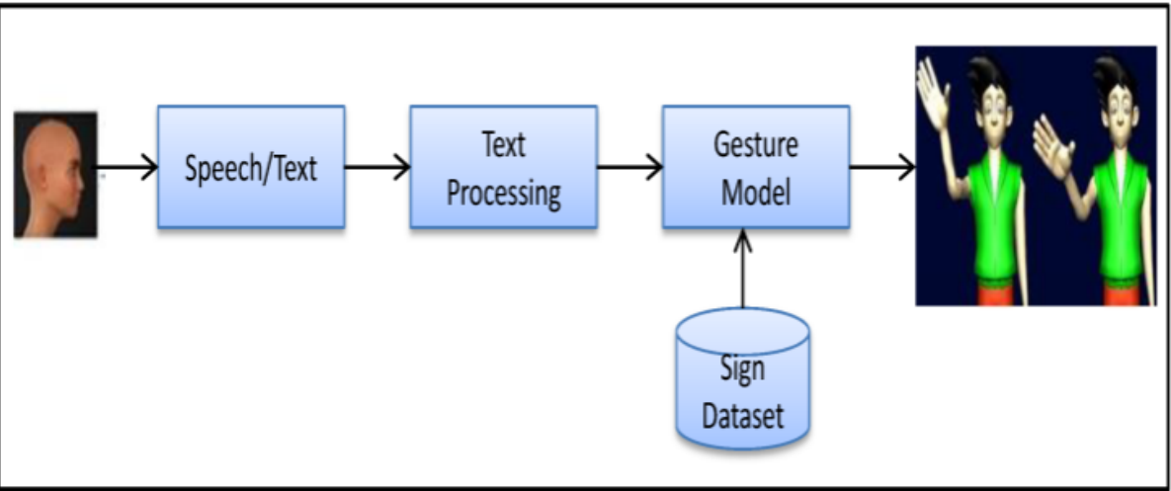
System workflow

Slide 10
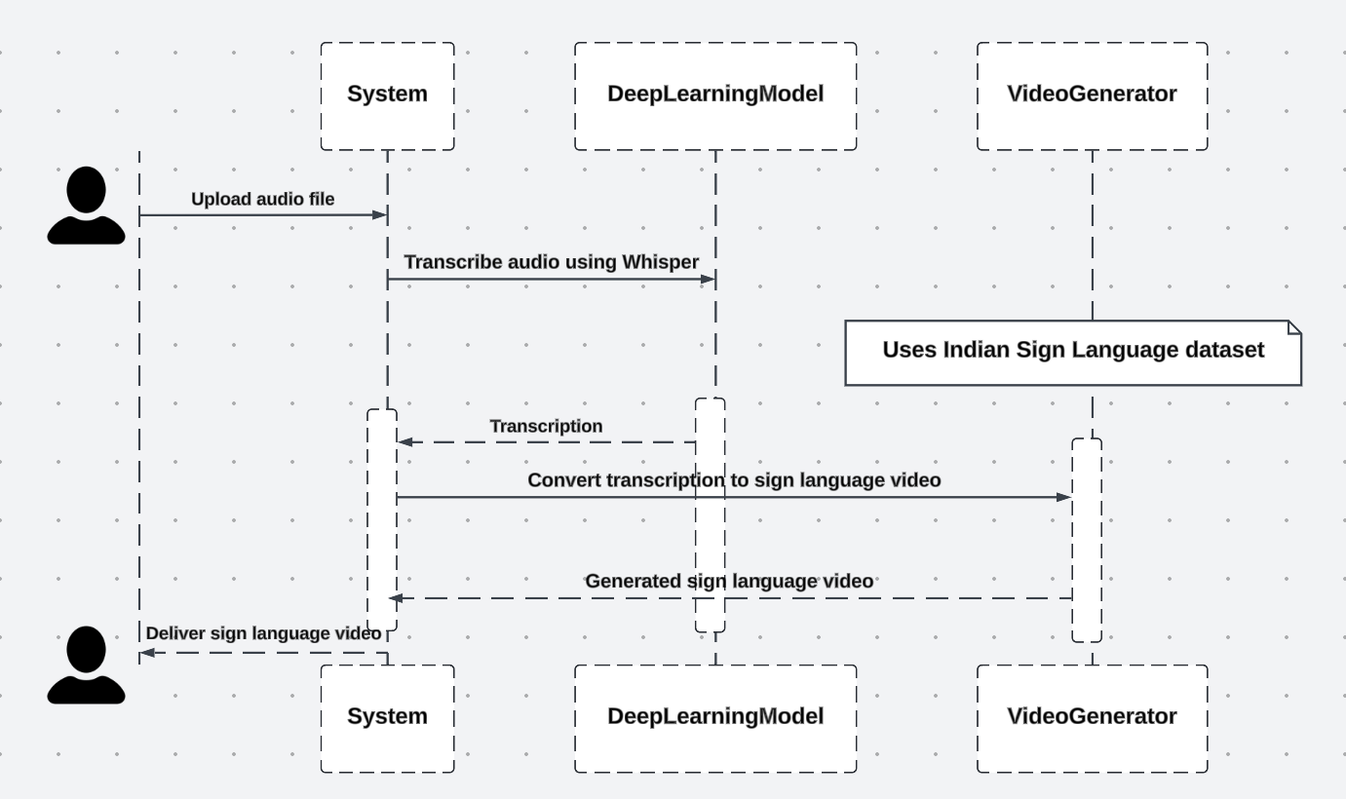
System workflow

Slide 11
conclusion
SignBridge is a groundbreaking solution that bridges communication gaps for deaf and mute individuals by converting spoken and written language into sign language videos in real-time. Leveraging advanced machine learning techniques and a comprehensive ISL video dataset, SignBridge promotes inclusivity and accessibility in various settings. By fostering better understanding and empowering communities, SignBridge ensures that communication is no longer a barrier, paving the way for a more connected and inclusive world. Moving forward, the focus will be on expanding the video dataset, improving model accuracy, and incorporating additional sign language features, enhancing the overall communication experience for all users.

Slide 12
Research papers
K. K. Bonthu, N. C, M. Padmini and M. P, "A Survey Paper on Emerging Techniques Used to Translate Audio or Text to Sign Language," 2023 International Conference on Advances in Electronics, Communication, Computing and Intelligent Information Systems (ICAECIS)
N. J, S. Bhat, R. R. Nair and T. Babu, "Audio to Sign Language conversion using Natural Language Processing," 2022 3rd International Conference on Communication, Computing and Industry 4.0 (C2I4), Bangalore, India, 2022, pp. 1-6, doi: 10.1109/C2I456876.2022.10051414.
A. Yadav, R. Saxena, B. Saini, V. K. Verma and V. Srivastava, "Audio to Sign Language Translator Web Application," 2021 International Conference on Computational Performance Evaluation (ComPE), Shillong, India, 2021, pp. 321-326, doi: 10.1109/ComPE53109.2021.9751857.
A. Dixit et al., "Audio to Indian and American Sign Language Converter using Machine Translation and NLP Technique," 2022 Third International Conference on Intelligent Computing Instrumentation and Control Technologies (ICICICT), Kannur, India, 2022, pp. 874-879, doi: 10.1109/ICICICT54557.2022.9917614.

Slide 13
Research papers
M. Rajanishree, N. Nadeem Ahmed, Y. Panchani, S. Aravindan and V. Jadhav, "Sign Language Conversion to Speech with the Application of KNN Algorithm," 2022 Sixth International Conference on I-SMAC (IoT in Social, Mobile, Analytics and Cloud) (I-SMAC)
A. Kanvinde, A. Revadekar, M. Tamse, D. R. Kalbande and N. Bakereywala, "Bidirectional Sign Language Translation," 2021 International Conference on Communication information and Computing Technology (ICCICT), Mumbai, India, 2021, pp. 1-5, doi: 10.1109/ICCICT50803.2021.9510146.
A. Yadav, R. Saxena, B. Saini, V. K. Verma and V. Srivastava, "Audio to Sign Language Translator Web Application," 2021 International Conference on Computational Performance Evaluation (ComPE), Shillong, India, 2021, pp. 321-326, doi: 10.1109/ComPE53109.2021.9751857.

Slide 14
Thank you
Happy family

